Slide 1
From Death to Life: My Life Story By Marcia A. Murphy

Slide 2
I was born on May 4, 1954, and was brought up in the Lutheran denomination of Protestant Christianity.

Slide 3
At 14 years of age
I was the president
of the student government—the first female to hold that office in the school’s history.

Slide 4
However, there was a lot of
turmoil in my family that caused distress.

Slide 5
I also felt rejected by my siblings.

Slide 6
At 17 years of age, I ventured into the Unitarian Universalist Society seeking new ideas yet found it unfulfilling.

Slide 7
Trying to escape the emotional upheaval in family where I felt rejected, I got pulled into a cult at the tender age of 18.

Slide 8
It was the cult of the Korean, Sun Myung Moon
Unification Church

Slide 9
While in this cult and in New York City, I started to hear voices. This went on for a year and a half. It was 18 months of horror.

Slide 10
The unleashed horror continued day and night. I went without rest……

Slide 11
Loud demonic voices terrorized me, bombarding me with obscenities and false accusations. I was unable to communicate this hellish world with anyone.

Slide 12
A thunderstorm brought a torrent of water slamming against the rocky cliffs; lightening flashed, lighting the sky, and thunder crashed. Then…
I heard
a
voice in the rain!

Slide 13
Believe in Jesus Christ and you’ll be SAVED!!

Slide 14
From that moment on I began to go in a different direction. I looked for a way out of the cult, a way back home.

Slide 15
I was hospitalized at the University of Iowa Psychopathic Hospital. [photo: 1935]

Slide 16
My spiritual life that had begun its slow ascent allowed me to survive.
A psychiatrist told my mother that I had
Schizophrenia
Clinical depression
Post traumatic stress disorder (PTSD).

Slide 17
Upon release from the hospital I tried to work but my emotional problems, extreme poverty, and social isolation prevented it.
The only thing I could hold on to—was my faith
The only thing that gave me hope—was my faith in God

Slide 18
Stigma contributed to my deep despair
I was treated disrespectfully.

Slide 19
I tried to attend churches but had no transportation.
Still, I read the
Bible and….

Slide 20
prayed….

Slide 21
I tried to work but failed at employment countless times.

Slide 22
I took college courses and also educated myself.
I wrote essays, prose, and poetry.

Slide 23
I got married….and divorced.

Slide 24
At 39 years of age, I reached a breaking point.

Slide 25
When I thought I could not find any more options, I nearly succeeded in killing myself….

Slide 26
A friend told me that at that point I seemed to have lost all my courage.

Slide 27
After the Suicide Attempt

Slide 28
In our hardest moments come the toughest questions… and the deepest answers. Craig Rennebohm (With David Paul) Authors

Slide 29
But then out of the depth of despair, I broke through into new life.

Slide 30
Kingdom of Light
For he has rescued us from the dominion of darkness and brought us into the kingdom of the Son he loves, the kingdom of LIGHT.
Col. 1:12b-13 (para)

Slide 31
The thief comes only to steal and kill and destroy; I have come that they may have life, and have it to the full. John 10:10

Slide 32
I started to read the Bible every morning for a time of devotions and prayer, and I sought God’s guidance.

Slide 33
I learned that ethical development and morality are key elements in my recovery from mental illness.

Slide 34
I learned these elements of
good mental health:
Doing no harm to others/respecting the rights of others
Treating others with kindness & patience
Meeting situations with a sense of justice & fairness
Having compassion

Slide 35
Also obeying God’s commands as written in the Bible

Slide 36
Listening to inspirational music brought healing and comfort.

Slide 37
Hope
May the God of hope fill you with all joy and peace…

Slide 38
I did a lot of reading on the subject of psychosis and religious experiences, how they resemble one another…

Slide 39
I became a volunteer in the Patients’ Library University of Iowa Hospitals & Clinics

Slide 40
I read books to children patients
And was given the
Above & Beyond Award

Slide 41
Writing about Recovery Mental Illness and Related Issues
My Website:
hopeforrecovery.com
Resources On
Spirituality
and
Mental Health

Slide 42
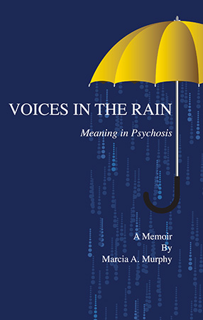
Voices in the Rain Meaning in Psychosis A Memoir
Allbooks Review International
Editor‘s Choice Award
for 2011 Finalist
At
Amazon.com
Local Library

Slide 43
Not that we are competent in ourselves to claim anything for ourselves, but our competence comes from God. 2Cor 3:5

Slide 44
New Path of Life
I was now on the path of forgiveness, righteousness, justice and wholeness:
~A new Way~
The fulfillment of hopes & dreams

Slide 45
After working in the Patients’ Library for several years, I became the statistician there.

Slide 46
I also have written small grants to obtain needed items for the psychiatric units.

Slide 47
I have given presentations for medical students
At the University of Iowa
Hospitals and Clinics

Slide 48
Created patient, student, and staff educational PowerPoint slideshows
#2 How to Move Forward
#1 Recovery from Mental Illness

Slide 49
In January 2012, I went to the State Capitol in Des Moines, Iowa

Slide 50
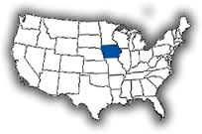
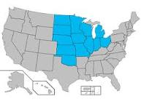
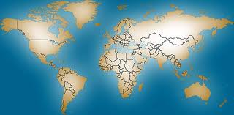
Over a period of 20 years I have
created and distributed
written materials and media

Slide 51
Physical Health Is Also Important

Slide 52
Recovery is…
Not necessarily absence of all symptoms
Level of stability
Meaningful work
Form significant relationships
Contributing to society
Mental illness does not define who I am
Identity comes from positive sources

Slide 53
There will always be people who will tell you that your dreams are too big, your hopes too unattainable. Ignore them.

Slide 54
Spiritual Protection In Jesus Christ’s Name
[Jesus prayed]:
Holy Father, protect them by the power of your name, the name you gave me…

Slide 55
“I am the light of the world. Whoever follows me will never walk in darkness, but will have the light of life.” John 8:12

Slide 56
By Marcia A. Murphy 2015
Credits
Bible NIV [New International Version]
Rennebohm, Craig (with Paul, David), Souls in the Hands of a Tender God; Boston, Mass: Beacon Press, c2008
A Hero in Every Heart, H. Jackson Brown, Jr. & Robyn Spizman; c1996

